Slide 1

Unit 1
Physical Layer
Reference Book:
Computer Networks (Andrew Tanembaum)
Data Communication & Networking (Behrouz Forozan)

Slide 2
Topic : 1
Introduction of LAN; MAN;WAN; PAN, Ad-hoc Network

Slide 3
Introduction of Network
Network: A network is defined as a group of two or more computer systems linked together.
Types of Networks:
LAN
MAN
WAN
PAN
Ad-hoc Network

Slide 4
Local Area Networks (LAN)
floor/building-wide
single communication medium
no routing, broadcast
segments connected by switches or hubs
high bandwidth, low latency
Ethernet - 10Mbps, 100Mbps, 1Gbps
no latency guarantees

Slide 5
LAN- Local Area Network
It is designed for small physical areas such as an office, group of buildings or a factory.
LANs are used widely as it is easy to design and to troubleshoot.
Personal computers and workstations are connected to each other through LANs.
We can use different types of topologies through LAN, these are Star, Ring, Bus,Tree etc.
LAN can be a simple network like connecting two computers, to share files and network among each other while it can also be as complex as interconnecting an entire building.
LAN networks are also widely used to share resources like
printers, shared hard-drive etc.

Slide 6
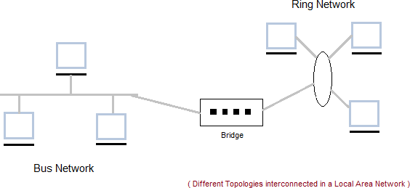
LAN Diagram

Slide 7
LAN Advantages
Cost reductions through sharing of information and databases, resources and network services.
Increased information exchange between different departments in an organization, or between individuals.
The trend to automate communication and manufacturing process.

Slide 8
LAN Disadvantages
Special security measures are needed to stop users from using programs and data that they should not have access to;
Networks are difficult to set up and need to be
maintained by skilled technicians.
If the file server develops a serious fault, all the users are affected, rather than just one user in the case of a stand-alone machine.

Slide 9
Applications
One of the computer in a network can become a server serving all the remaining computers called clients. Software can be stored on the server and it can be used by the remaining clients.
Connecting Locally all the workstations in a building to let them communicate with each other locally without any internet access.
Sharing common resources like printers etc are some common applications of LAN.

Slide 10
MAN- Metropolitan Area Network
It is basically a bigger version of LAN.
It is also called MAN and uses the similar technology as LAN.
It is designed to extend over the entire city.
It can be means to connecting a number of LANs into a larger network or it can be a single cable.
It is mainly hold and operated by single private company or a public company.

Slide 11
MAN- Metropolitan Area Network continued….
Metropolitan Area Networks (MAN)
city-wide, up to 50 km
Digital Subscriber Line (DSL): .25 - 8 Mbps, 5.5km from switch
BellSouth: .8 to 6 Mbps
Cable modem: 1.5 Mbps, longer range than DSL
Bright house w/ Road Runner: .5 to 10Mbps

Slide 12
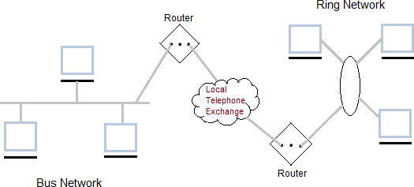
MAN Diagram

Slide 13
MAN-Advantages
It provides a good back bone for a large network and provides greater access to WANs.
The dual bus used in MAN helps the transmission of data in both direction simultaneously.
A Man usually encompasses several blocks of a city or an entire city.

Slide 14
MAN-Disadvantages
More cable required for a MAN connection from one place to another.
It is difficult to make the system secure from hackers and industrial espionage (spying) graphical regions.

Slide 15
MAN Applications
The MAN can be used to provide services including
telecoms,
Internet access,
television and
CCTV to businesses and citizens in these metropolitan areas.

Slide 16
WAN-Wide Area Network
Wide Area Network (WAN)
It is also called WAN.WAN can be private or it can be public leased network.
It is used for the network that covers large distance such as cover states of a country.
It is not easy to design and maintain.
Communication medium used by WAN are PSTN or Satellite links.
WAN operates on low data rates.

Slide 17
WAN-Wide Area Network…continued
Wide Area Networks (WAN)
world-wide
Different organizations
Large distances
routed, latency .1 - .5 seconds

Slide 18
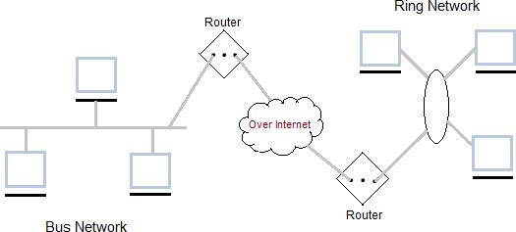
WAN Diagram

Slide 19
WAN Advantages
Covers a large geographical area so long distance businesses can connect on the one network.
Shares software and resources with connecting workstations.
Messages can be sent very quickly to anyone else on the network
Expensive things (such as printers or phone lines to
the internet) can be shared by all the computers on the network without having to buy a different peripheral for each computer.
Everyone on the network can use the same data. This
avoids problems where some users may have older information than others.

Slide 20
WAN Disadvantages
Need a good firewall to restrict outsiders from entering and disrupting the network
Setting up a network can be an expensive, slow and complicated. The bigger the network the more expensive it is.
Once set up, maintaining a network is a full-time job
which requires network supervisors and technicians to be employed.
Security is a real issue when many different people have
the ability to use information from other computers.
Protection against hackers and viruses adds more complexity and expense.

Slide 21
PAN-Personal Area Network
PAN stands for personal area network, a network covering a very small area, usually a small room.
PAN’s can be wired or wireless.
The best known wireless PAN network technology is Bluetooth, and the most popular wired PAN is USB.
Wi-Fi also serves as a PAN technology, since Wi-Fi is also used over a small area.

Slide 22
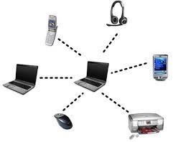
PAN- Diagram

Slide 23
PAN-Advantages
 The pan is a personal network of one or two person so there is no risk of any leak of data.

Slide 24
PAN-Disadvantages
The network it can only travel straight up to 10mts and if in different rooms then only 2mts.
In the case of infrared the infra red sensor bust be in a straight line otherwise it won't communicate.
Transmission speed is slow to moderate.

Slide 25
Ad-hoc Networks
A wireless ad hoc network (WANET) or MANET is a decentralized type of wireless network.
The network is ad hoc because it does not rely on a pre- existing infrastructure, such as routers in wired networks or access points in managed (infrastructure) wireless networks.
Ad-hoc means without base station or Access point
(means without infrastructure)

Slide 26
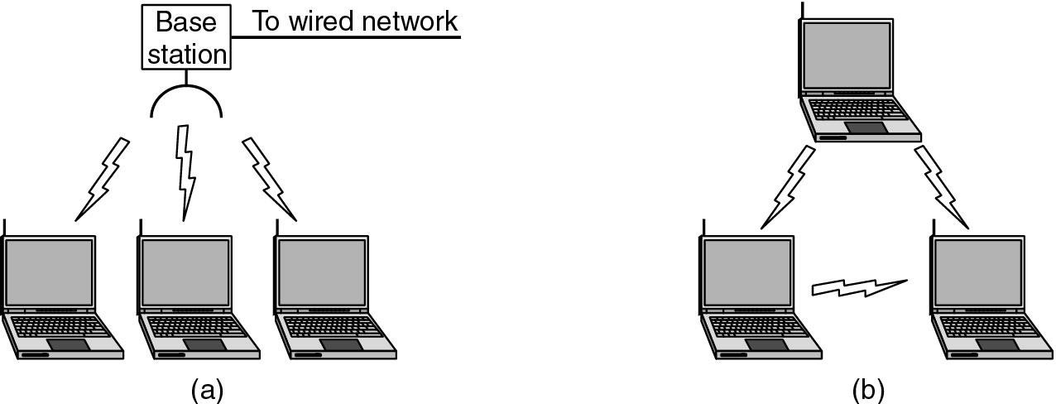
Ad-hoc Network Diagram
Figure (a) Wireless networking with a base station.
(b) Ad hoc networking.

Slide 27
Ad-hoc Network Advantages
Ad-hoc networks can have more flexibility.
It is better in mobility.
It can be turn up and turn down in a very short time.
It can be more economical.
It considered a robust network because of its
non-
hierarchical distributed control and mechanisms
management

Slide 28
Ad-hoc Network Disadvantages
Hostile environment and irregular connectivity.
There are no known boundaries for the maximum range that nodes will be able to receive network frames.
The wireless channel is weak, unreliable, and unprotected from outside interferences.
Limited wireless range.
Hidden terminals.
Packet losses.
Routes changes.
Devices heterogeneity.
Battery power constraints.

Slide 29


Ad-hoc Network Applications
Group of people with laptops and they want to exchange files and data without having an access point.
Incase if we need to exchange information and the network's infrastructure has been destroyed.
It is suitable for military communications at battlefield where there is no network infrastructure.

Slide 30
Other Wireless Networks
Wireless local area networks (WLAN)
IEEE 802.11 (WiFi)
 10-100 Mbps, 1.5km
 802.11 (1997): upto 2 Mbps, 2.4 GHz
802.11a (1999): upto 54 Mbps, 5 GHz, ~75 feet outdoor
802.11b (1999): upto 11 Mbps, 2.4 GHz, ~150 feet [most popular]
 802.11g (2003): upto 54 Mbps, 2.4 GHz, ~150 feet [backward compatible with 802.11b, becoming more popular]
Wireless metropolitan area networks (WMAN)
IEEE 802.16 (WiMax)
 1.5-20 Mbps, 5-50km

Slide 31
Other Wireless Networks
Wireless wide area networks (WWAN)
worldwide
GSM (Global System for Mobile communications)
 9.6 – 33 kbps
3G (“third generation”): 128-384 kbps to 2Mbps

Slide 32
Other Networks
Internetworks
connecting different kinds of networks
routers, gateways

Slide 33
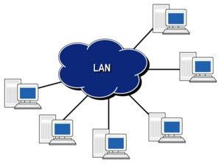
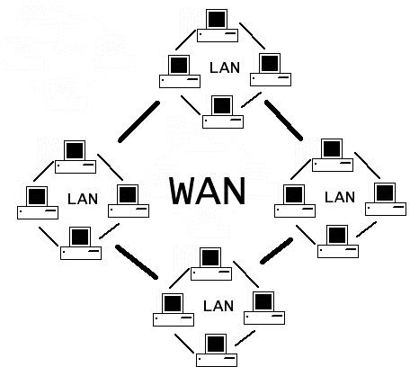
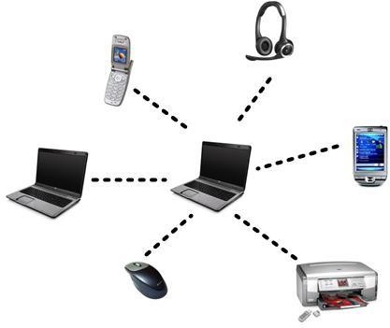
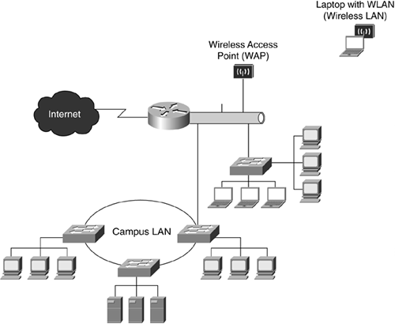
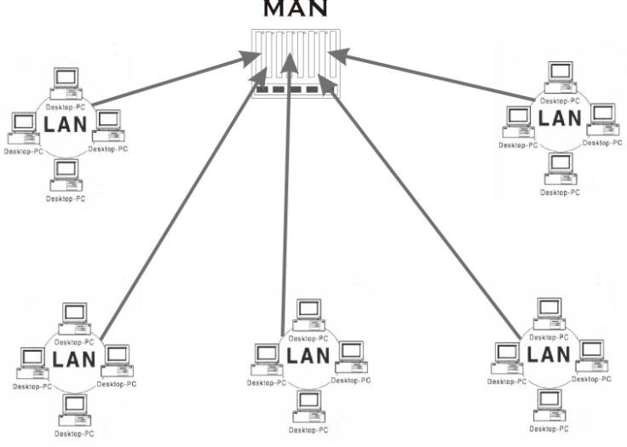
WAN
LAN
PAN
CAN
MAN

Slide 34
DISTINGUISH BETWEEN LAN,WAN,MAN
PARAMETERS | LAN | WAN | MAN
Ownership of network | Private | Private or public | Private or public
Geographical area covered | Small | Very large | Moderate
Design and maintenance | Easy | Not easy | Not easy
Communication medium | Twisted Pair cable (UTP) | PSTN or satellite links | Coaxial cables, PSTN, optical fibre, cables, wireless
Bandwidth | Low | High | moderate
Data rates(speed) | High | Low | moderate

Slide 35
Network performance
Wired: | Example | Range | Bandwidth (Mbps) | Latency
LAN | Ethernet | 1-2 km | 10-1000 | 1-10
MAN | ATM | 250 km | 1-150 | 10
WAN | IP routing | worldwide | .01-600 | 100-500
Internetwork | Internet | worldwide | 0.5-600 | 100-500
Wireless: WPAN | Bluetooth (802.15.1) | 10 - 30m | 0.5-2 | 5-20
WLAN | WiFi (IEEE 802.11) | 0.15-1.5 km | 2-54 | 5-20
WMAN | WiMAX (802.16) | 550 km | 1.5-20 | 5-20
WWAN | GSM, 3G phone nets | worldwide | 0.01-2 | 100-500
(ms)

Slide 36
Topic - 2
Topologies

Slide 37
Topologies-Types of Network Topology
BUS
RING
STAR
MESH
TREE
HYBRID

Slide 38
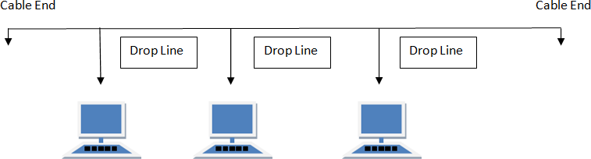
BUS Topology
Bus topology is a network type in which every computer and network device is connected to single cable.When it has exactly two endpoints, then it is called Linear Bus topology.
Features of Bus Topology
It transmits data only in one direction. Every device is connected to a single cable

Slide 39
BUS Topology
Advantages of Bus Topology
It is cost effective.
Cable required is least compared to other network topology.
Used in small networks.
It is easy to understand.
Easy to expand joining two cables together.
Disadvantages of Bus Topology
Cables fails then whole network fails.
If network traffic is heavy or nodes are more the performance of the network decreases.
Cable has a limited length.
It is slower than the ring topology.

Slide 40
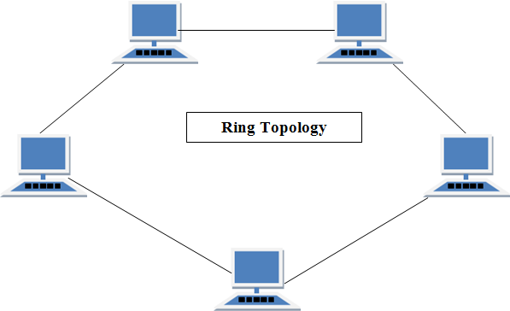
RING Topology
It is called ring topology because it forms a ring as each computer is connected to another
computer, with the last one connected to the first. Exactly two neighbours for each device.

Slide 41
Features of Ring Topology
A number of repeaters are used for Ring topology with large number of nodes, because if someone wants to send some data to the last node in the ring topology with 100 nodes, then the data will have to pass through 99 nodes to reach the 100th node. Hence to prevent data loss repeaters are used in the network.
The transmission is unidirectional, but it can be made bidirectional by having 2 connections between each Network Node, it is called Dual Ring Topology.
In Dual Ring Topology, two ring networks are formed, and data flow is in opposite direction in them. Also, if one ring fails, the second ring can act as a backup, to keep the network up.
Data is transferred in a sequential manner that is bit by bit. Data transmitted, has to pass through each node of the network, till the destination node.

Slide 42
Ring Topology
Advantages of Ring Topology
Transmitting network is not affected by high traffic or by adding more nodes, as only the nodes having tokens can transmit data.
Cheap to install and expand
Disadvantages of Ring Topology
Troubleshooting is difficult in ring topology.
Adding or deleting the computers disturbs the network activity.
Failure of one computer disturbs the whole network.

Slide 43
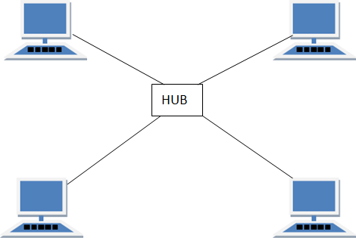
STAR Topology
In this type of topology all the computers are connected to a single hub through a cable. This hub is the central node and all others nodes are connected to the central node.
Features of Star Topology
Every node has its own dedicated connection to the hub. Hub acts as a repeater for data flow.
Can be used with twisted pair, Optical Fibre or coaxial cable.

Slide 44
STAR Topology
Advantages of Star Topology
Fast performance with few nodes and low network traffic.
Hub can be upgraded easily.
Easy to troubleshoot.
Easy to setup and modify.
Only that node is affected which has failed, rest of the nodes can work smoothly.
Disadvantages of Star Topology
Cost of installation is high.
Expensive to use.
If the hub fails then the whole network is stopped because all the nodes
depend on the hub.
Performance is based on the hub that is it depends on its capacity

Slide 45
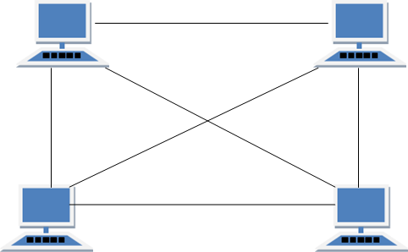
MESH Topology
It is a point-to-point connection to other nodes or devices.All the network nodes are connected to each other. Mesh has n(n-1)/2 physical channels to link n devices.
Features of Mesh Topology
Fully connected. Robust.
Not flexible.

Slide 46
MESH Topology
Advantages of Mesh Topology
Each connection can carry its own data load.
It is robust.
Fault is diagnosed easily.
Provides security and privacy.
Disadvantages of Mesh Topology
Installation and configuration is difficult.
Cabling cost is more.
Bulk wiring is required.

Slide 47
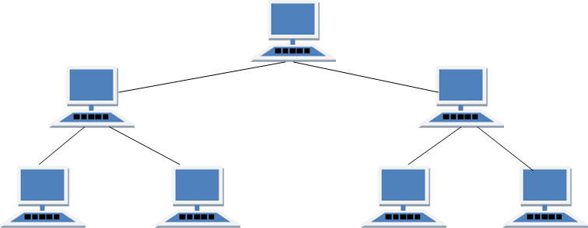
TREE Topology
It has a root node and all other nodes are connected to it forming a hierarchy. It is also called hierarchical topology. It should at least have three levels to the hierarchy.
Features of Tree Topology
Ideal if workstations are located in groups. Used in Wide Area Network.

Slide 48
TREE Topology
Advantages of Tree Topology
Extension of bus and star topologies.
Expansion of nodes is possible and easy.
Easily managed and maintained.
Error detection is easily done.
Disadvantages of Tree Topology
Heavily cabled.
Costly.
If more nodes are added maintenance is difficult.
Central hub fails, network fails.

Slide 49
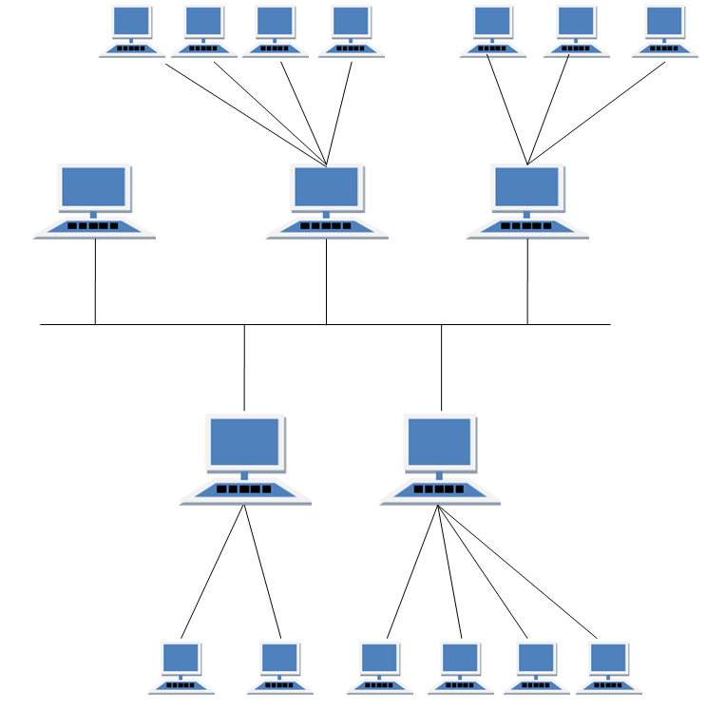
HYBRID Topology
It is two different types of topologies which is a mixture of two or more topologies. For example if in an office in one department ring topology is used and in another star topology is used, connecting these topologies will result in Hybrid Topology (ring topology and star topology).

Slide 50
HYBRID Topology
Features of Hybrid Topology
It is a combination of two or topologies
Inherits the advantages and disadvantages of the topologies
included
Advantages of Hybrid Topology
Reliable as Error detecting and trouble shooting is easy.
Effective.
Scalable as size can be increased easily.
Flexible.
Disadvantages of Hybrid Topology
Complex in design.
Costly.

Slide 51
Topic 3
Network Architectures OSI Model

Slide 52




NETWORK CLASSIFICATION BY THEIR COMPONENT ROLE
LOCAL AREA NETWORK
PEER TO PEER NETWORK
CLIENT SERVER NETWORK

Slide 53
PEER TO PEER NETWORK
A peer-to-peer network is a distributed network architecture composed of participants that make a portion of their resources, such as processing power, disk storage or network bandwidth directly to network participants without the need for central coordination instances.
Used largely for sharing of content files such as audio, video, data or anything in a digital format.
There are many p2p protocols such as Ares, Bittorrent, or eDonkey.
Can be very large
Can also be used for business solutions for relatively small companies that may not have resources available to implement a server solution.
Peer to peer network is useful for a small network containing less than 10 computers on a single LAN .
In peer to peer network each computer can function as both client and server.
Peer to peer networks do not have a central control system.There are no servers in peer networks.
Peer networks are amplified into home group.

Slide 54
ADVANTAGES & DISADVANTAGES OF PEER TO PEER NETWORK
Advantages:
Use less expensive computer
hardware
Easy to administer
No NOS required
More built in redundancy
Easy setup & low cost
Disadvantages:
Not very secure
No central point of storage or file archiving
Additional load on computer because of resource sharing
Hard to maintain version control

Slide 55
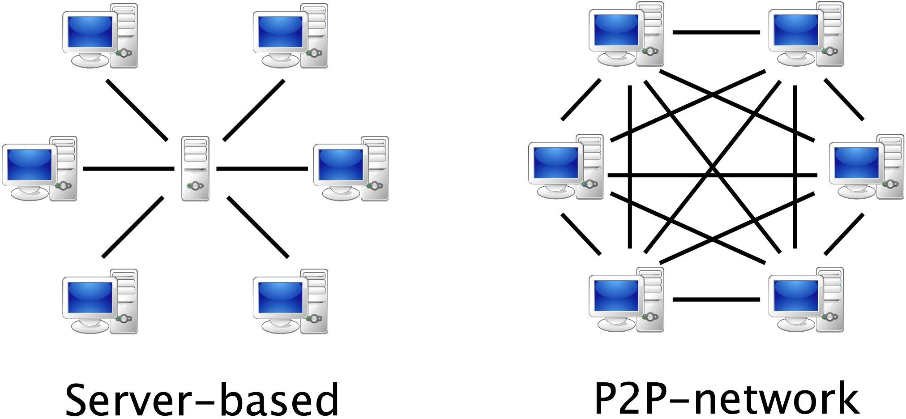

Slide 56
CLIENT/SERVER NETWORK
In client-server network relationships, certain computers act as server and other act as clients. A server is simply a computer, that available the network resources and provides service to other computers when they request it. A client is the computer running a program that requests the service from a server.
Local area network(LAN) is based on client server network relationship.
A client-server network is one n which all available network resources such as files, directories, applications and shared devices, are centrally managed and hosted and then are accessed by client.
Client serve network are defined by the presence of servers on a network that provide security and administration of the network.

Slide 57
ADVANTAGES AND DISADVANTAGES OF CLIENT-SERVER NETWORK
Advantages:
Very secure
Better performance
Centralized backup
very reliable
Disadvantages:
requires professional administration
More hardware-intensive
More software intensive
Expensive dedicated software

Slide 58






TYPES OF SERVERS

Slide 59
TYPES OF SERVERS
File server: These servers provide the services for storing, retrieving and moving the data. A user can read, write, exchange and manage the files with the help of file servers.
Printer server:The printer server is used for controlling and managing printing on the network. It also offers the fax service to the network users.
Application server: The expensive software and additional computing power can be shared by the computers in a network with he help of application servers.
Message server: It is used to co-ordinate the interaction between users, documents and applications.The data can be used in the for of audio, video, binary, text or graphics.
Database server: It is a type of application server. It allows the uses to access the centralised strong database.

Slide 60
Distributed Networks
Arrangement of networked computers in which several processors (the CPUs) are located on scattered machines, but are capable of working both independently and jointly as required.
The key elements of Distributed Network Architecture are, as the name implies, the distribution of decision-making and control out to each site, while simultaneously, networking and synchronizing the various sites together via a central hub.
Distributed networking is a distributed computing network system, said to be distributed when the computer programming and the data to be worked on are spread out across more than one computer. Usually, this is implemented over a computer network.

Slide 61
Benefits of Distributed Network Architecture
Scalability: Enterprise solutions that rely on a single Enterprise server inevitably suffer from performance issues as the Enterprise grows and the server is overwhelmed.
Moreover, single server solutions are highly susceptible to network failures.
Cost: Servers and software at each local site can be appropriately sized to meet the specific needs of each site, without requiring installing an expensive server at even the smallest sites.
Reliability: Distributed Network Architecture is much more tolerant of network and hardware failures than a single server approach.

Slide 62
SDN- Software Defined Network

Slide 63
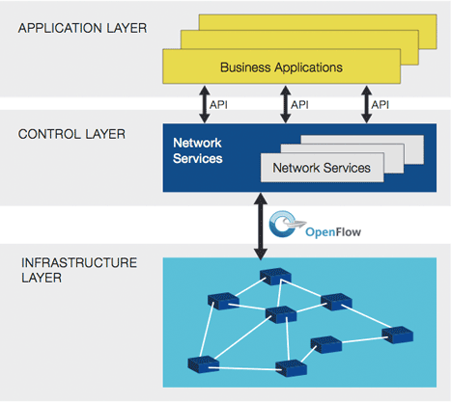
SDN Architecture

Slide 64
Need /Goal of SDN
 The goal of SDN is to allow network engineers and administrators to respond quickly to changing business requirements. In a software-defined network, a network administrator can shape traffic from a centralized control console without having to touch individual switches, and can deliver services to wherever they are needed in the network, without regard to what specific devices a server or other hardware components are connected to.The key technologies for SDN implementation are functional separation, network virtualization and automation through programmability.

Slide 65











SDN Concept
Software-defined networking (SDN) is an approach to computer networking that allows network administrators to manage network services through abstraction of higher-level functionality.
This is done by decoupling the system that makes decisions about where traffic is sent (the control plane) from the underlying systems that forward traffic to the selected destination (the data plane).
SDN requires some method for the control plane to communicate with the data plane. One such mechanism is OpenFlow.

Slide 66




SDN Concept
Separate Control plane and Data plane entities
Network intelligence and state are logically centralized
The underlying network infrastructure is abstracted from the applications
Execute or run Control plane software on general purpose hardware
Decouple from specific networking hardware
Use commodity servers
Have programmable data planes
Maintain, control and program data plane state from a central entity
An architecture to control not just a networking device but an entire network

Slide 67






SDN Benefits
Dynamic , Manageable ,cost-effective, adaptable
Directly programmable
Agile: administrators dynamically adjust network-wide traffic flow to meet changing needs.
Centrally managed
Programmatically configured: SDN lets network managers configure, manage, secure, and optimize network resources very quickly via dynamic, automated SDN programs
Open standards-based and vendor-neutral

Slide 68
Outline
Introduction of LAN; MAN;WAN; PAN, Ad-hoc Network
Topologies
Network Architectures
OSI Model
TCP/IP Model
Design issues for Layers Transmission Mediums Network Devices
Manchester and Differential Manchester Encodings;
IEEE802.11: Frequency Hopping (FHSS) and Direct Sequence (DSSS)

Slide 69

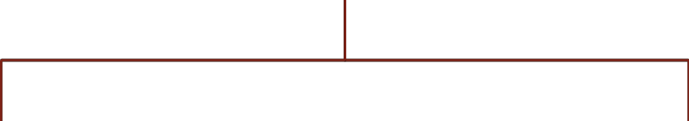


Reference Models in Communication Networks
The most important reference models are :
OSI reference model.
TCP/IP reference model.

Slide 70
OSI
There are many users who use computer network and are located all over the world.To ensure national and worldwide data communication ISO (ISO stands for International Organization of Standardization.) developed this model.
This is called a model for open system interconnection (OSI) and is normally called as OSI model.
OSI model architecture consists of seven layers.
It defines seven layers or levels in a complete communication system.

Slide 71
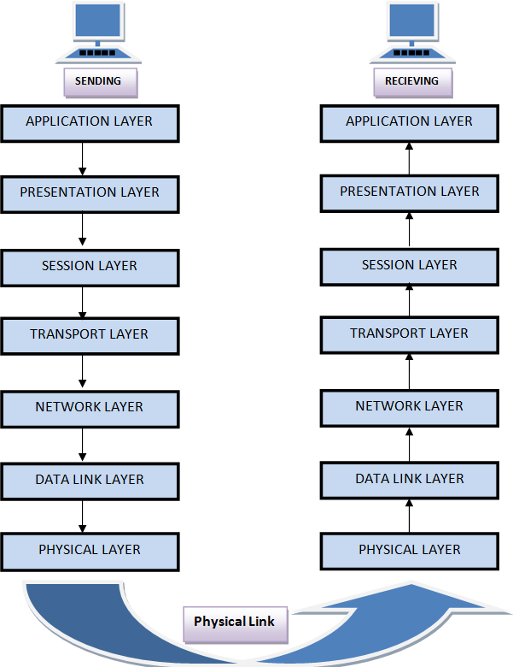
OSI Model

Slide 72
Feature of OSI Model :
Big picture of communication over network is understandable through this OSI model.
We see how hardware and software work together.
We can understand new technologies as they are developed.
Troubleshooting is easier by separate networks.
Can be used to compare basic functional relationships on different networks.

Slide 73
Layer 1: The Physical Layer :
It is the lowest layer of the OSI Model.
It activates, maintains and deactivates the physical connection.
It is responsible for transmission and reception of the unstructured raw data over network.
Voltages and data rates needed for transmission is defined in the physical layer.
It converts the digital/analog bits into electrical signal or optical signals.
Data encoding is also done in this layer.

Slide 74
Layer 2: Data Link Layer
Data link layer synchronizes the information which is to be transmitted over the physical layer.
The main function of this layer is to make sure data transfer is
error free from one node to another, over the physical layer.
Transmitting and receiving data frames sequentially is managed by this layer.
This layer sends and expects acknowledgements for frames received and sent respectively. Resending of non- acknowledgement received frames is also handled by this layer.
This layer establishes a logical layer between two nodes and also manages the Frame traffic control over the network. It signals the transmitting node to stop, when the frame buffers are full.

Slide 75
Layer 3: The Network Layer
It routes the signal through different channels from one node to other.
It acts as a network controller. It manages the Subnet traffic.
It decides by which route data should take.
It divides the outgoing messages into packets and assembles the incoming packets into messages for higher levels.

Slide 76
Layer 4: Transport Layer
It decides if data transmission should be on parallel path or single path.
Functions such as Multiplexing, Segmenting or Splitting on the data are done by this layer
It receives messages from the Session layer above it, convert the message into smaller units and passes it on to the Network layer.
Transport layer can be very complex, depending upon the network requirements.
Transport layer breaks the message (data) into small units so that they are handled more efficiently by the network layer.

Slide 77
Layer 5: The Session Layer
Session layer manages and synchronize the conversation between two different applications.
Transfer of data from source to destination session layer streams of data are marked and are resynchronized properly, so that the ends of the messages are not cut prematurely and data loss is avoided.

Slide 78
Layer 6: The Presentation Layer
Presentation layer takes care that the data is sent in such a way that the receiver will understand the information (data) and will be able to use the data.
While receiving the data, presentation layer transforms the data to be ready for the application layer.
Languages (syntax) can be different of the two communicating systems. Under this condition presentation layer plays a role of translator.
It perfroms Data compression, Data encryption, Data conversion etc.

Slide 79
Layer 7: Application Layer
It is the topmost layer.
Transferring of files disturbing the results to the user is also done in this layer. Mail services, directory services, network resource etc are services provided by application layer.
This layer mainly holds application programs to act upon the received and to be sent data.

Slide 80
Merits of OSI reference model
OSI model distinguishes well between the services, interfaces and protocols.
Protocols of OSI model are very well hidden.
Protocols can be replaced by new protocols as technology changes.
Supports connection oriented services as well as connectionless service.

Slide 81
Demerits of OSI reference model:
Model was devised before the invention of protocols.
Fitting of protocols is tedious task.
It is just used as a reference model.

Slide 82
Outline
Introduction of LAN; MAN;WAN; PAN, Ad-hoc Network
Topologies
Network Architectures OSI Model
TCP/IP Model
Design issues for Layers Transmission Mediums Network Devices
Manchester and Differential Manchester Encodings;
IEEE802.11: Frequency Hopping (FHSS) and Direct Sequence (DSSS)

Slide 83
TCP/IP model overview
TCP/IP that is Transmission Control Protocol and Internet Protocol was developed by Department of Defence's Project Research Agency (ARPA, later DARPA) as a part of a research project of network interconnection to connect remote machines.
The features of TCP/IP reference model were:
Support for a flexible architecture. Adding more machines to a network was easy.
The network was robust, and connections remained intact untill the source and destination machines were functioning.
The overall idea was to allow one application on one computer to talk to(send data packets) another application running on different computer.

Slide 84
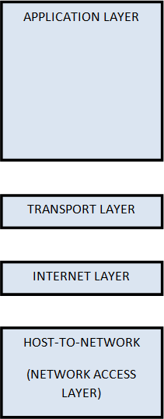
TCP/IP reference model diagram

Slide 85
Layer 1: Host-to-network Layer
Lowest layer of the all.
Protocol is used to connect to the host, so that the packets can be sent over it.
Varies from host to host and network to network.

Slide 86
Layer 2: Internet layer
Selection of a packet switching network which is based on a connectionless internetwork layer is called a internet layer.
It is the layer which holds the whole architecture together.
It helps the packet to travel independently to the destination.
Order in which packets are received is different from the way they are sent.
IP (Internet Protocol) is used in this layer.

Slide 87
Layer 3: Transport Layer
It decides if data transmission should be on parallel path or single path.
Functions such as multiplexing, segmenting or splitting on the data is done by transport layer.
The applications can read and write to the transport layer.
Transport layer adds header information to the data.
Transport layer breaks the message (data) into small units so that they are handled more efficiently by the network layer.
Transport layer also arrange the packets to be sent, in sequence.

Slide 88
Layer 4: Application Layer
The TCP/IP specifications described a lot of applications that were at the top of the protocol stack. Some of them were TELNET, FTP, SMTP, DNS etc.
TELNET is a two-way communication protocol which allows connecting to a remote machine and run applications on it.
FTP(File Transfer Protocol) is a protocol, that allows File transfer amongst computer users connected over a network. It is reliable, simple and efficient.
SMTP(Simple Mail Transport Protocol) is a protocol, which is used to transport electronic mail between a source and destination, directed via a route.
DNS(Domain Name Server) resolves an IP address into a textual
address for Hosts connected over a network.

Slide 89
Merits of TCP/IP model
It operated independently.
It is scalable.
Client/server architecture.
Supports a number of routing protocols.
Can be used to establish a connection between two computers.

Slide 90
Demerits of TCP/IP
In this, the transport layer does not guarantee delivery of packets.
The model cannot be used in any other application.
Replacing protocol is not easy.
It has not clearly separated its services, interfaces and protocols.

Slide 91
Comparison of OSI Reference Model and TCP/IP Reference Model
OSI(Open System Interconnection) | TCP/IP(Transmission Control Protocol / Internet Protocol)
1. OSI is a generic, protocol independent standard, acting as a communication gateway between the network and end user. | 1.TCP/IP model is based on standard protocols around which the Internet has developed. It is a communication protocol, which allows connection of hosts over a network.
2. In OSI model the transport layer guarantees the delivery of packets. | 2. In TCP/IP model the transport layer does not guarantees delivery of packets. Still the TCP/IP model is more reliable.
3. Follows vertical approach. | 3. Follows horizontal approach.
4. OSI model has a separate Presentation layer and Session layer. | 4.TCP/IP does not have a separate Presentation layer or Session layer.
5. OSI is a reference model around which the networks are built. Generally it is used as a guidance tool. | 5.TCP/IP model is, in a way implementation of the OSI model.

Slide 92
Comparison of OSI Reference Model and TCP/IP Reference Model
OSI(Open System Interconnection) | TCP/IP(Transmission Control Protocol / Internet Protocol)
6. Network layer of OSI model provides both connection oriented and connectionless service. | 6.The Network layer in TCP/IP model provides connectionless service.
7. OSI model has a problem of fitting the protocols into the model. | 7.TCP/IP model does not fit any protocol
8. Protocols are hidden in OSI model and are easily replaced as the technology changes. | 8. In TCP/IP replacing protocol is not easy.
9. OSI model defines services, interfaces and protocols very clearly and makes clear distinction between them. It is protocol independent. | 9. In TCP/IP, services, interfaces and protocols are not clearly separated. It is also protocol dependent.
10. It has 7 layers | 10. It has 4 layers

Slide 93
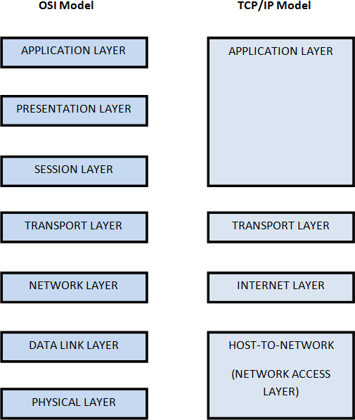
Diagrammatic Comparison between OSI Reference Model and TCP/IP Reference Model

Slide 94
Outline
Introduction of LAN; MAN;WAN; PAN, Ad-hoc Network
Topologies
Network Architectures OSI Model
TCP/IP Model
Design issues for Layers
Transmission Mediums Network Devices
Manchester and Differential Manchester Encodings;
IEEE802.11: Frequency Hopping (FHSS) and Direct Sequence (DSSS)

Slide 95
Design issues for Layers
Addressing
Error Control
Flow Control
Multiplexing
Routing

Slide 96
Addressing
 Addressing Level
Unique address for each end system (computer) and each intermediate
system(router)
Network level address-IP or internet address (TCP/IP) Network service access point or NSAP (OSI)
Process within the system-Port number (TCP/IP)
Service access point or SAP
 Addressing Scope
Global nonambiguity-Global address identifies unique system,There is only one system with address X
Global applicability-It is possible at any system (any address) to identify
any other system (address) by the global address of the other system
Address X identifies that system from anywhere on the network
e.g. MAC address on IEEE 802 networks

Slide 97
Error Control
 Guard against loss or damage of data and control information Error control is implemented as two separate functions:
Error detection
Sender inserts error detecting bits Receiver checks these bits
If OK, acknowledge
If error, discard packet Retransmission
If no acknowledge in given time, re-transmit Performed at various layers of protocol

Slide 98
Flow Control
 Done by receiving entity
Function to limit amount or rate of data sent by a transmitting entity
Simplest form: stop-and-wait procedure
More efficient protocols: Credit systems Sliding window Needed at application as well as network layers

Slide 99
Multiplexing
 Supporting multiple connections on one machine
-Mapping of multiple connections at one level to a single connection at another
-Carrying a number of connections on one fiber optic cable
-Aggregating or bonding ISDN lines to gain bandwidth

Slide 100
Routing
 Determine path or route that packets will follow Use routing protocol based on a routing algorithm “Good” path should be least cost path
Cost : depends on the following factors. Average queuing delay
Propagation delay
Bandwidth, mean queue length, etc.
End systems and routers maintain routing tables Dynamic or static

Slide 101
Outline
Introduction of LAN; MAN;WAN; PAN, Ad-hoc Network
Topologies
Network Architectures OSI Model
TCP/IP Model
Design issues for Layers Transmission Mediums
Network Devices
Manchester and Differential Manchester Encodings;
IEEE802.11: Frequency Hopping (FHSS) and Direct Sequence (DSSS)

Slide 102
Transmission Mediums
 CAT5, 5e, 6
OFC and
Radio Spectrum,

Slide 103
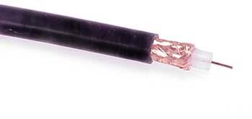
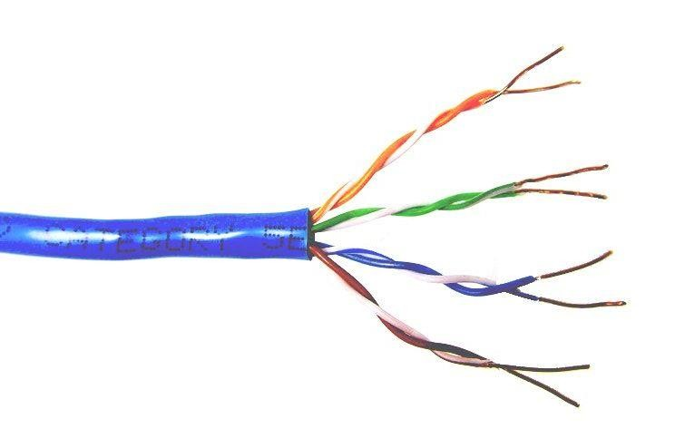
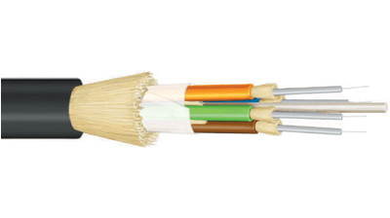
Common network cable types
 Coaxial cable
 Unshielded twisted pair
 Fiber optic

Slide 104
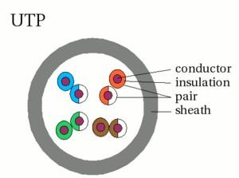
UTP characteristics
Unshielded
Twisted (why?) pairs of insulated conductors
Covered by insulating sheath

Slide 105
UTP categories
Category 1 | Voice only (Telephone)
Category 2 | Data to 4 Mbps (Localtalk)
Category 3 | Data to 10Mbps (Ethernet)
Category 4 | Data to 20Mbps (Token ring)
Category 5 Category 5e | Data to 100Mbps (Fast Ethernet) Data to 1000Mbps (Gigabit Ethernet)
Category 6 | Data to 2500Mbps (Gigabit Ethernet)

Slide 106
Categories of UTP: CAT 5
100 MHz Bandwidth
24.0 dB Attenuation
100 ohms Impedance
Used for high-speed data transmission
Used in 10BaseT (10 Mbps) Ethernet & Fast Ethernet (100 Mbps)

Slide 107
Categories of UTP: CAT 5e
150 MHz Bandwidth
24.0 dB Attenuation
100 ohms Impedance
Transmits high-speed data
Used in Fast Ethernet (100 Mbps), Gigabit Ethernet (1000 Mbps) & 155 Mbps ATM
For runs of up to 90 meters
Solid core cable ideal for structural installations (PVC or Plenum)
Stranded cable ideal for patch cables
Terminated with RJ-45 connectors

Slide 108
Categories of UTP: CAT 6
250 MHz Bandwidth
19.8 dB Attenuation
100 ohms Impedance
Transmits high-speed data
Used in Gigabit Ethernet (1000 Mbps) & 10 Gig Ethernet (10000
Mbps)

Slide 109
Comparison between CAT5,5e and 6
 | CAT5 | CAT5e | CAT6
Frequency | 100 MHz | 100 MHz | 250 MHz
Attenuation (min. at 100 MHz) | 22 dB | 22 dB | 19.8 dB
Characteristic Impedance | 100 ohms = 15% | 100 ohms = 15% | 100 ohms = 15%
NEXT (min. at 100 MHz) | 32.3 dB | 35.3 dB | 44.3 dB
PS-NEXT (min. at 100 MHz) | NA | 32.3 dB | 42.3 dB
EL-FEXT (min. at 100 MHz) | NA | 23.8 dB | 27.8 dB
PS-ELFEXT (min. at 100 MHz) | NA | 20.8 dB | 24.8 dB
PS-ANEXT (min. at 500 MHz) | -- | -- | --
PS-AELFEXT (min. at 500 MHz) | 16 dB | 20.1 dB | 20.1 dB
Return Loss (min. at 100 MHz) | 16 dB | 20.1 dB | 20.1 dB
Delay Skew (max. per 100m) | NA | 45 ns | 45 ns
Networks Supported | 100BASE-T | 1000BASE-T | 1000BASE-TX

Slide 110
OFC- Optical fiber cable
An optical fiber cable, also known as fiber optic cable, is an assembly similar to an electrical cable, but containing one or more optical fibers that are used to carry light.
The optical fiber elements are typically individually coated with plastic layers and contained in a protective tube suitable for the environment where the cable will be deployed.
Different types of cable are used for different applications, for example long distance telecommunication, or providing a high-speed data connection between different parts of a building.

Slide 111

Fiber Media
Optical fibers use light to send information through the optical medium.
It uses the principal of total internal reflection.
Modulated light transmissions are used to transmit the signal.

Slide 112
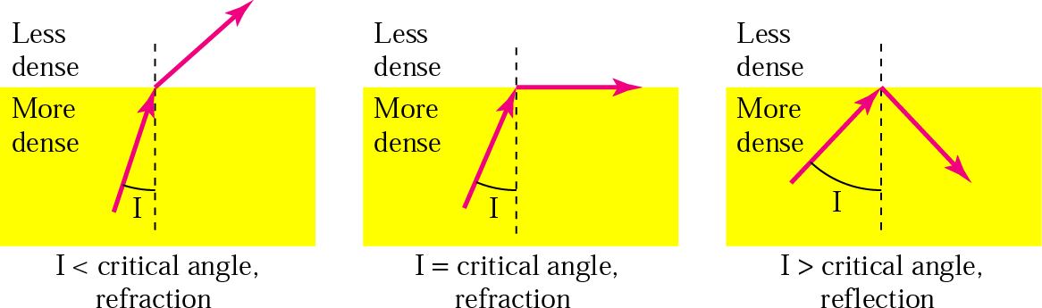
Total Internal Reflection

Slide 113
Fiber Media
Light travels through the optical media by the way of total internal reflection.
Modulation scheme used is intensity modulation.
Two types of Fiber media :
Multimode
Singlemode
Multimode Fiber can support less bandwidth than Singlemode Fiber.
Singlemode Fiber has a very small core and carry only one beam of light. It can support Gbps data rates over > 100 Km without using repeaters.

Slide 114
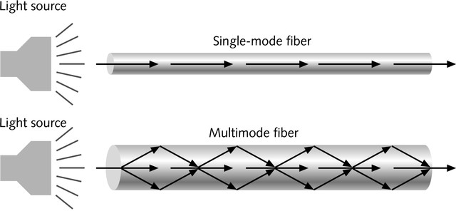
Single and Multimode Fiber
Single-mode fiber
Carries light pulses along single path
Uses Laser Light Source
Multimode fiber
Many pulses of light generated by LED travel at different angles

Slide 115
Fiber Media
The bandwidth of the fiber is limited due to the dispersion effect.
Distance Bandwidth product of a fiber is almost a constant.
Fiber optic cables consist of multiple fibers packed inside protective covering.
62.5/125 µm (850/1310 nm) multimode fiber
50/125 µm (850/1310 nm) multimode fiber
10 µm (1310 nm) single-mode fiber

Slide 116
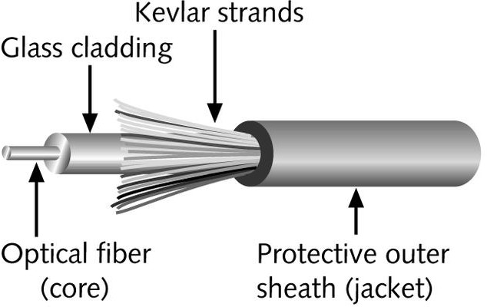
Fiber-Optic Cable
Contains one or several glass fibers at its core
Surrounding the fibers is a layer called cladding

Slide 117
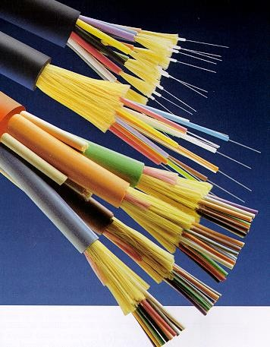
Fiber Optic Cable
 FO Cable may have 1 to over 1000 fibers

Slide 118
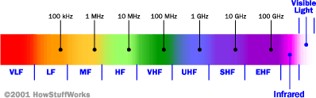
Radio Spectrum
The radio spectrum is the part of the electromagnetic spectrum from 3 Hz to 3000 GHz (3 THz).
Electromagnetic waves in this frequency range, called radio waves, are extremely widely used in modern technology, particularly in telecommunication.
Coordinated by an international body, the International Telecommunication Union (ITU)

Slide 119
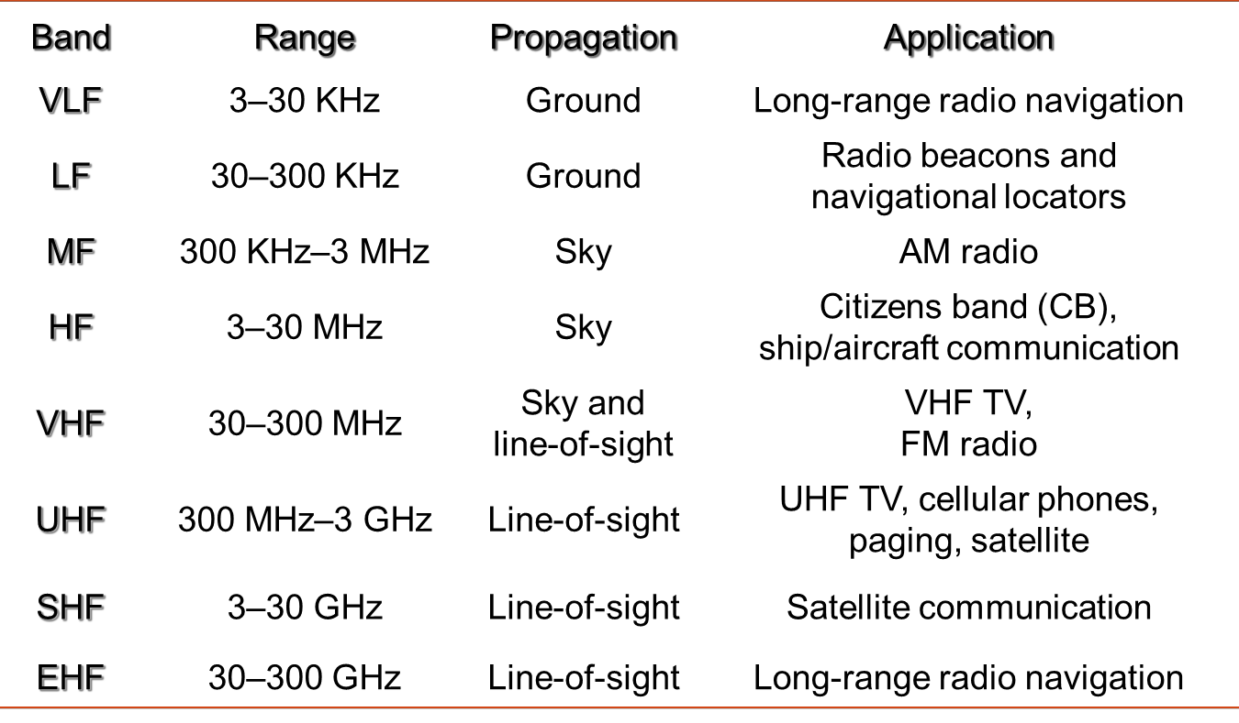
Frequency Band

Slide 120
Outline
Introduction of LAN; MAN;WAN; PAN, Ad-hoc Network
Topologies
Network Architectures OSI Model
TCP/IP Model
Design issues for Layers
Transmission Mediums Network Devices
Manchester and Differential Manchester Encodings;
IEEE802.11: Frequency Hopping (FHSS) and Direct Sequence (DSSS)

Slide 121
Devices and the layers at which they operate
Layer | Name of Layer | Device
3 | Network | Routers, layer 3 switches
2 | Data Link | Switches, bridges, NIC’s
1 | Physical | Hubs, Repeaters

Slide 122
Network Devices:
Bridge
Switch
Router
Brouter and
Access Point

Slide 123
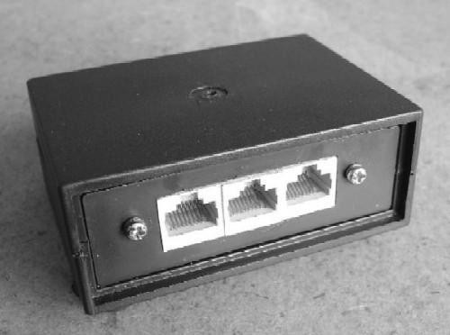
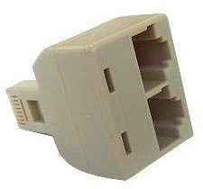
Hubs
A hub is used as a central point of connection among media segments.
Cables from network devices plug in to the ports on the hub.
Types of HUBS :
A passive hub is just a connector. It connects the wires
coming from different branches.
The signal pass through a passive hub without regeneration or amplification.
Connect several networking cables together
Active hubs or Multiport repeaters- They regenerate or amplify the signal before they are retransmitted.

Slide 124
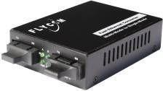
Repeaters
A repeater is a device that PHYSICAL layer.
operates only at the
A repeater can be used to increase the length of the network by eliminating the effect of attenuation on the signal.
It connects two segments of the same network, overcoming the distance limitations of the transmission media.
A repeater forwards every frame it has no filtering capability.
A repeater is a regenerator, not an amplifier.
Repeaters can connect segments that have the same access method. (CSMA/CD,Token Passing, Polling, etc.)
Optic fiber repeater

Slide 125
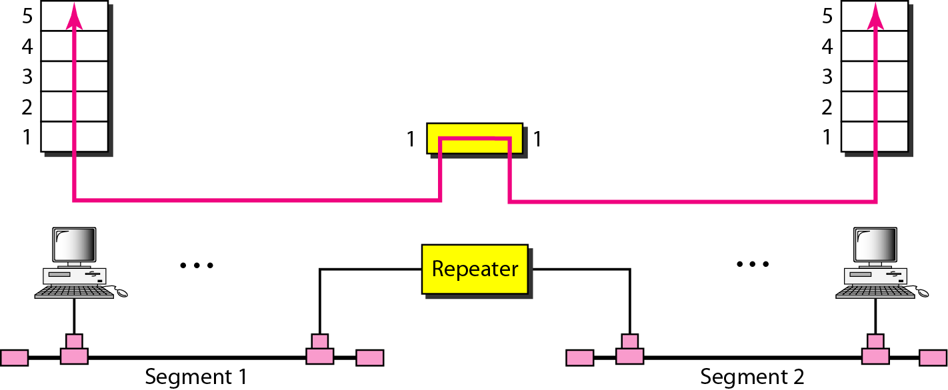
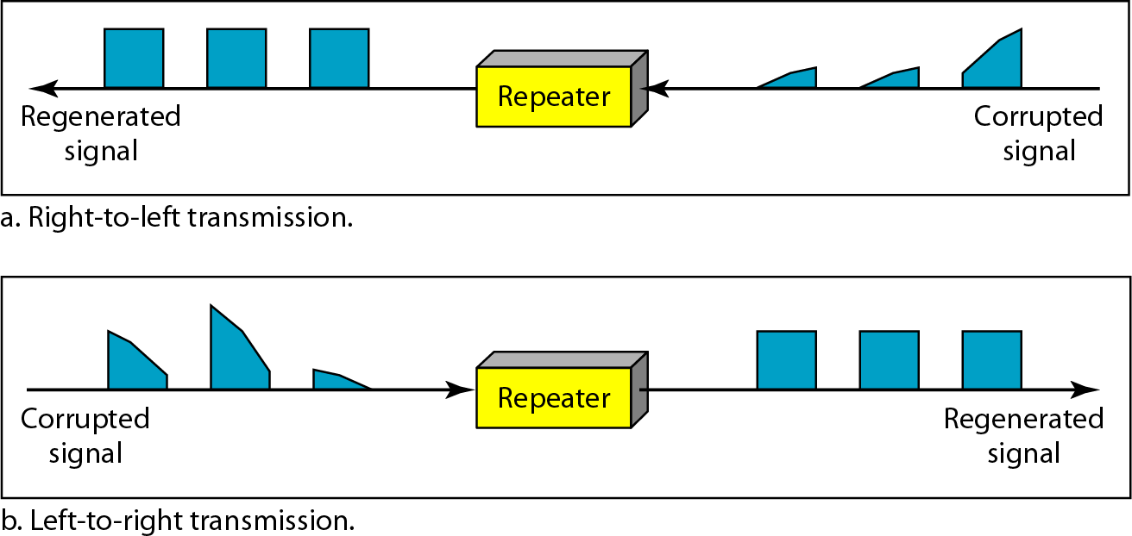
Rep
eater connecting two segments of a LAN
Function of a repeater

Slide 126
Switches
A network switch is a computer networking device that connects devices together on a computer network by using packet switching to receive, process, and forward data to the destination device.
Unlike less advanced network hubs, a network switch forwards data only to the devices that need to receive it, rather than broadcasting the same data out of each of its ports.
It uses Ethernet (MAC Address) address.

Slide 127
Store and Forward Switches
Do error checking on each frame after the entire frame has arrived into the switch
If the error checking algorithm determines there is no error, the switch looks in its MAC address table for the port to which to forward the destination device
Highly reliable because doesn’t forward bad frames
Slower than other types of switches because it holds on to each frame until it is completely received to check for errors before forwarding

Slide 128
Cut Through Switch
Faster than store and forward because doesn’t perform error checking on frames
Reads address information for each frame as the frames enter the switch
After looking up the port of the destination device, frame is forwarded
Forwards bad frames
 Performance penalty because bad frames can’t be used and replacement frames must be sent which creates additional traffic

Slide 129
Unmanaged/Intelligent switches
Unmanaged – provides LAN’s with all the benefits of switching. Fine in small networks
Intelligent switches tracks and reports LAN performance statistics. Have a database ASIC (application specific integrated circuit) on board to collect and store data which you view through a software interface

Slide 130
Comparison of Hub and Switch
Basis for Comparison | Hub | Switch
Layer | Physical layer. Layer 1 devices | Data Link Layer. Layer 2
Function | To connect a network of personal computers together, they can be joined through a central hub. | Allow to connect multiple device and port can be manage,Vlan can create security also can apply
Data Transmission | Electrical signal or bits | Frame (L2 Switch) Frame & Packet (L3 switch)
Ports | 4/12 ports | Switch is multi port Bridge. 24/48 ports
Device Type | Passive Device (Without Software) | Active Device (With Software) & Networking device
Used in | LAN | LAN
Transmission Mode | Half duplex | Half/Full duplex
Broadcast Domain | Hub has one Broadcast Domain. | Switch has one broadcast domain
Definition | An electronic device that connects many network device together so that devices can exchange data | A network switch is a computer networking device that is used to connect many devices together on a computer network. A switch is considered more advanced than a hub because a switch will on send msg to device that needs or request it
Speed | 10Mbps | 10/100 Mbps, 1 Gbps
Collisions | Collisions occur in setups using hubs. | No collisions occur in a full-duplex switch.
Address Used | Uses MAC address | Uses MAC address

Slide 131
Bridges
Operates in both the PHYSICAL and the data linklayer.
As a
PHYSICAL layer device, it regenerates
the signal
it receives.
As a data link layer device, the
bridge can check
the PHYSICAL/MAC addresses(source and destination) contained in the frame.
A bridge has a table used in filtering decisions.
It can check the destination address of a frame and decide if the frame should be forwarded or dropped.
If the frame is to be forwarded, the decision mustspecify the port.
A bridge has a table that maps address to ports.
Limit or filter traffic keeping local traffic local yet allow connectivity to other parts (segments).

Slide 132
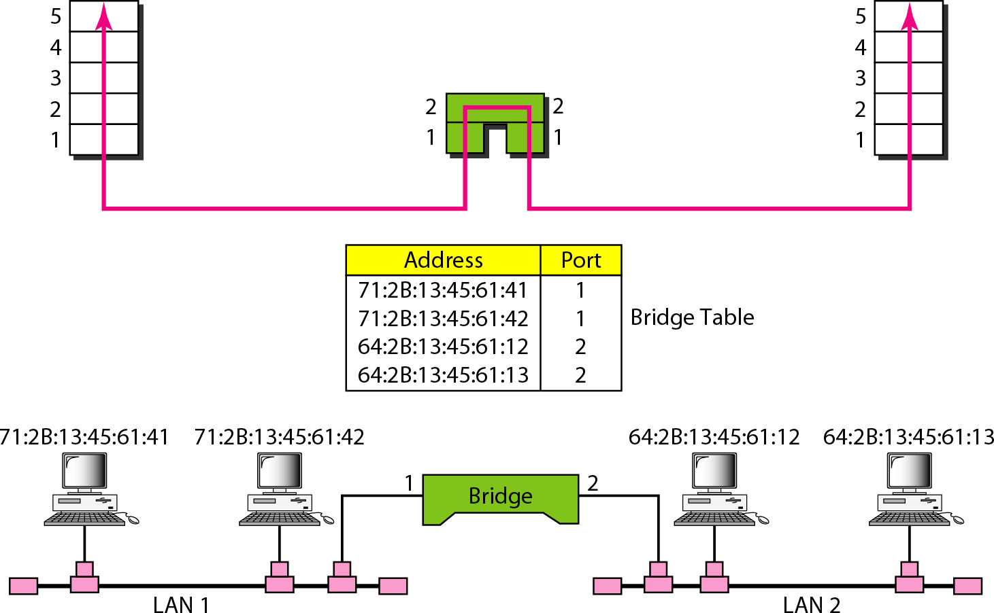
A bridge connecting two LANs
A bridge does not change the physical (MAC) addresses in a frame.

Slide 133
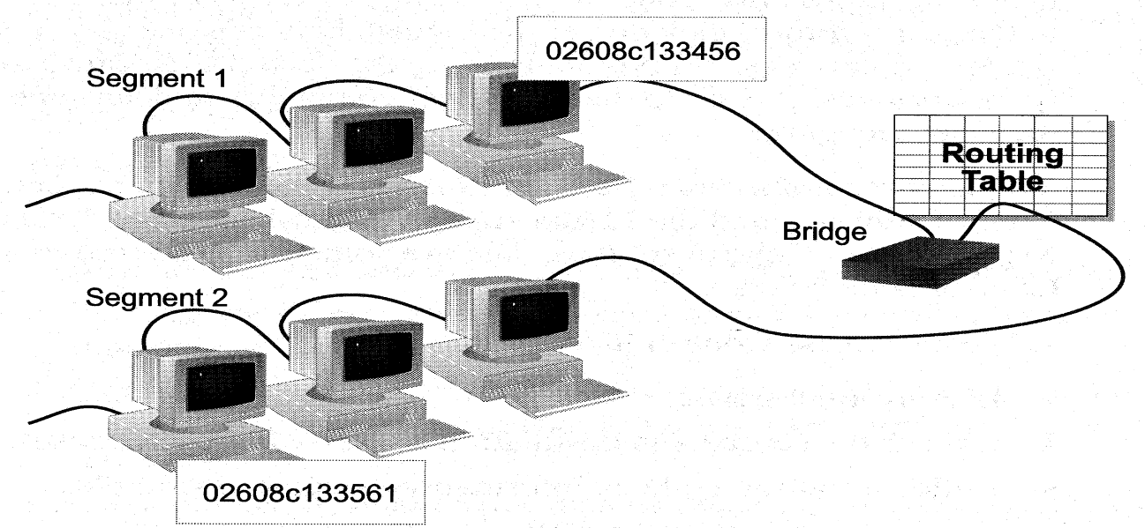
How BridgesWork
Bridges work at the Media Access Control
Routing table is built to record the segment no. of address
If destination address is in the same segment as the source address, stop transmit
Otherwise, forward to the other segment

Slide 134







Characteristics of Bridges
Routing Tables
Contains one entry per station of network to which bridge is
connected.
Is used to determine the network of destination station of a received packet.
Is used by bridge to allow only those packets destined to the remote network.
Packets are filtered with respect to their destination and multicast addresses.
Filtering
Forwarding
the process of passing a packet from one network to another.
Learning Algorithm
the process by which the bridge learns how to reach stations on the internetwork.

Slide 135
Types of Bridges
Transparent Bridge
Also called learning bridges
Build a table of MAC addresses as frames arrive
Ethernet networks use transparent bridge
Duties of transparent bridge are : Filtering frames,
forwarding and blocking
Source Routing Bridge
Used in Token Ring networks
Each station should determine the route to the destination when it wants to send a frame and therefore include the route information in the header of frame.
Addresses of these bridges are included in the frame.
Frame contains not only the source and destination address but also
the bridge addresses.

Slide 136
Advantages And Disadvantages Of Bridges
Advantages of using a bridge
Extend physical network
Reduce network traffic with minor segmentation
Creates separate collision domains
Reduce collisions
Connect different architecture
Disadvantages of using bridges
Slower that repeaters due to filtering
Do not filter broadcasts
More expensive than repeaters

Slide 137
Comparison of Switch and Bridge
Switch | Bridge
A switch when compared to bridge has multiple ports. Switches can perform error checking before forwarding data. Switches are very efficient by not forwarding packets that error-ed out or forwarding good packets selectively to correct devices only. Switches can support both layer 2 (based on MAC Address) and layer 3 (Based on IP address) depending on the type of switch. Usually large networks use switches instead of hubs to connect computers within the same subnet. | Bridge has a single incoming and outgoing port. A bridge maintains a MAC address table for both LAN segments it is connected to. Bridge filters traffic on the LAN by looking at the MAC address. Bridge looks at the destination of the packet before forwarding unlike a hub. It restricts transmission on other LAN segment if destination is not found. Bridges are used to separate parts of a network that do not need to communicate regularly, but need to be connected.

Slide 138
Two and Three layer switches
Two layer switch operate at PHY and data link layer
Three layer switch operates at network layer
Bridge is an example of two-layer switch.
Bridge with few port can connect a few LANs
Bridge with many port may be able to allocate a unique port to each station, with each station on its own independent entity.This means no competing traffic (no collision as we saw in Ethernet)

Slide 139
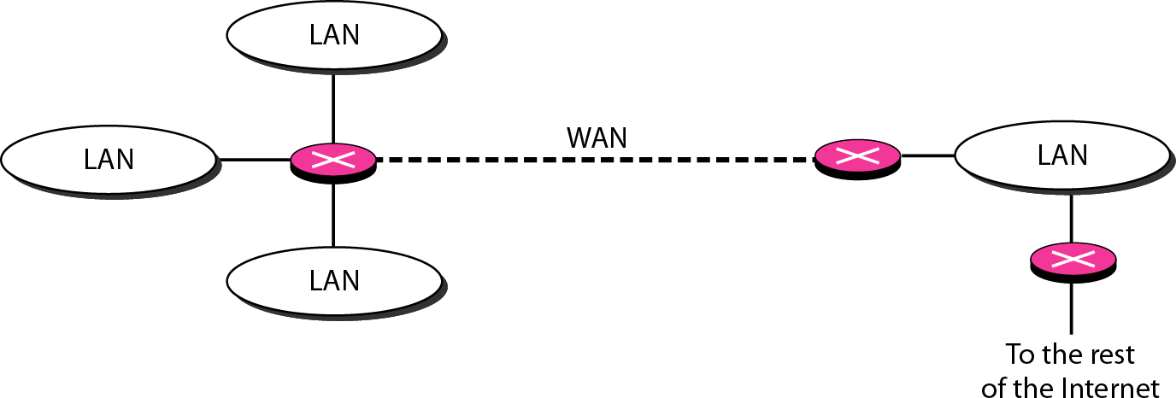
3-layer switches- Router
Routes packets based on their logical addresses (host-to-host addressing)
A router normally connects LANs and WANs in the Internet and has a routing table that is used for making decision about the route.
The routing tables are normally dynamic and are updated using routing protocols.
Routers connecting independent LANs and WANs

Slide 140
Advantages and Disadvantages of Routers
Advantages
Routers
-provide sophisticated routing, flow control, and traffic isolation
-are configurable, which allows network manager to make policy based on routing decisions
-allow active loops so that redundant paths are available
Disadvantages
Routers
are protocol-dependent devices that must understand the protocol they are forwarding.
can require a considerable amount of initial
configuration.
are relatively complex devices, and generally are more expensive than bridges.

Slide 141
Routers versus Bridges
Addressing
Routers are explicitly addressed.
Bridges are not addressed.
Availability
Routers can handle failures in links, stations, and other routers.
Bridges use only source and destination MAC address, which does not guarantee delivery of frames.
Message Size
» Routers can perform fragmentation on packets and thus handle different packet sizes.
» Bridges cannot do fragmentation and should not forward a frame which is too big for the next LAN.
Forwarding
» Routers forward a message to a specific destination.
» Bridges forward a message to an outgoing network.

Slide 142

Priority
» Routers can treat packets according to priorities
» Bridges treat all packets equally.
Error Rate
» Network layers have error-checking algorithms that examines each received packet.
» The MAC layer rate.
Security
provides a very low undetected bit error
» Both bridges and routers provide the ability to put “security walls” around specific stations.
» Routers generally provide greater security than bridges because
they can be addressed directly and
they use additional data for implementing security.

Slide 143
Brouters: Bridging Routers
Combine features of bridges and routers.
Capable of establishing a bridge between two networks as well as routing some messages from the bridge networks to other networks.
Are sometimes called (Layer 2/3) switches and are a combination of bridge/router hardware and software.

Slide 144
Gateway
Interchangeably used term router and gateway
Connect two networks above the network layer of OSI model.
Are capable of converting data frames and network
protocols into the format needed by another network.
Provide for translation services between different computer protocols.
Transport gateways make a connection between two networks at the transport layer.
Application gateways connect two parts of an application in the application layer, e.g., sending email between two machines using different mail formats
Broadband-modem-router is one e.g. of gateway

Slide 145
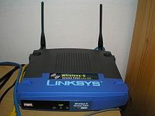
Access Point
 In computer networking, a wireless access point (WAP) is a networking hardware device that allows a Wi-Fi device to connect to a wired network.The WAP usually connects to a router (via a wired network) as a standalone device, but it can also be an integral component of the router itself.

Slide 146
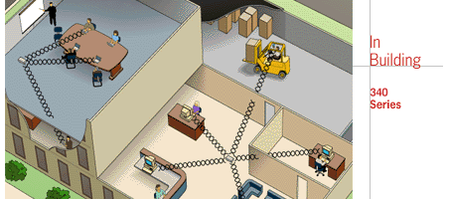
Access Point
 Access Point(AP) units serve areas of a building, similar to base units of cordless telephones except each AP can connect to many computers. APs serve as network bridges between the wired and wireless portions of the network.

Slide 147
Outline
Introduction of LAN; MAN;WAN; PAN, Ad-hoc Network
Topologies
Network Architectures OSI Model
TCP/IP Model
Design issues for Layers
Transmission Mediums Network Devices
Manchester and Differential Manchester Encodings;
IEEE802.11: Frequency Hopping (FHSS) and Direct Sequence (DSSS)

Slide 148










Encoding
Coding is the process of embedding clocks into a given data stream and
producing a signal that can be transmitted over a selected medium.
Transmitter is responsible for "encoding" i.e. inserting clocks into data according to a selected coding scheme
Receiver is responsible for "decoding" i.e. separating clocks and data from the incoming embedded stream.
A signal needs to be manipulated in such a way so that it contains identifiable changes that are recognizable to the sender and receiver.
There are 4 possible encoding techniques that can be used on the data: Digital- to-digital, Digital-to-Analog, Analog-to-analog, Analog-to-digital.

Slide 149
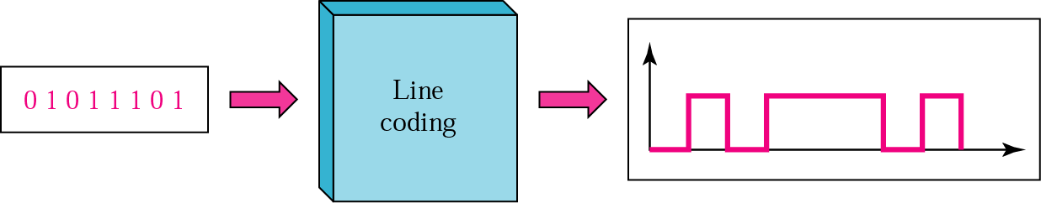
Digital-to-Digital Encoding
The binary signals created by your computer (DTE) are translated into a sequence of voltage
pulses that can be sent through the transmission medium.
Binary signals have two basic parameters: amplitude and duration.
As the number of bits sent per unit of time increases, the bit duration decreases.
The three most common methods of encoding used are: unipolar , polar , and bipolar .

Slide 150
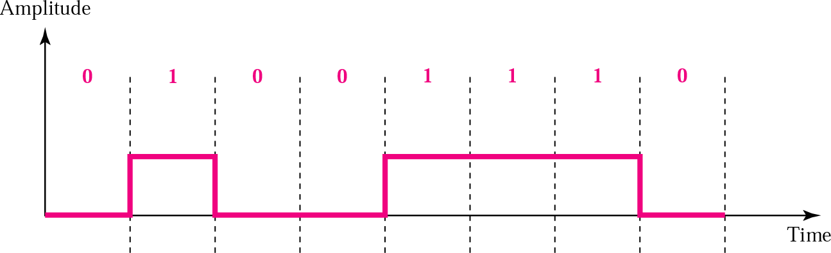
UNIPOLAR ENCODING
Unipolar encoding uses only one voltage level.

Slide 151
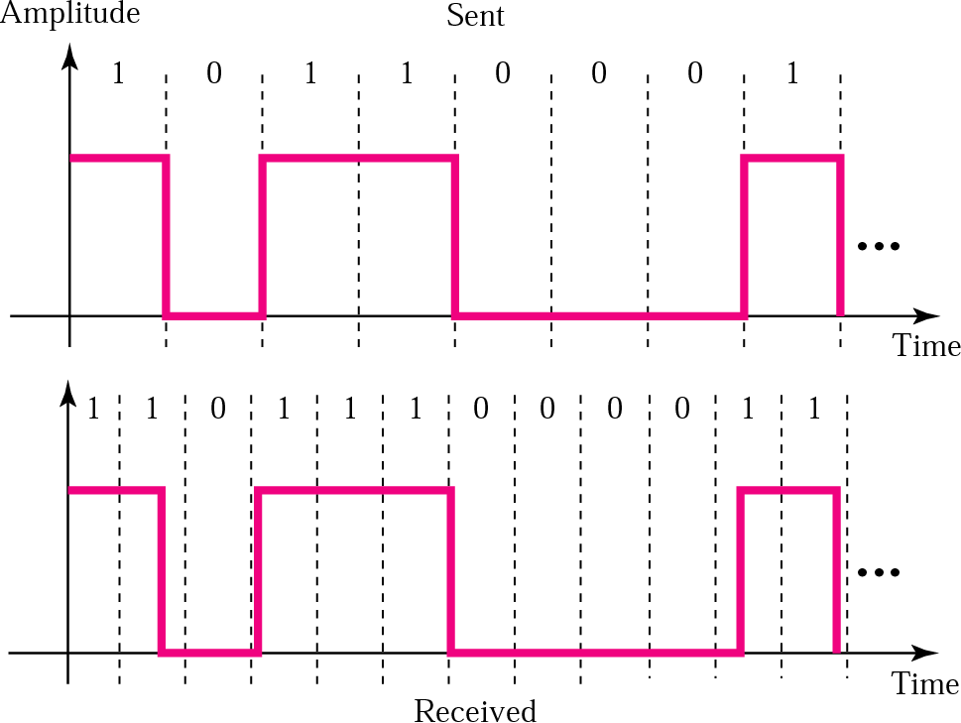
Lack of synchronization

Slide 152
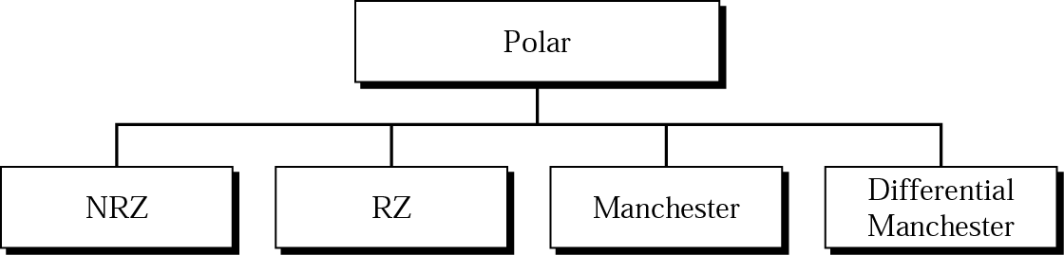



POLAR ENCODING
Polar encoding uses two voltage levels (positive and negative).

Slide 153
Manchester
(or diphase or biphase encoding)
This code is self-clocking.
Provides a transition for every bit in the middle of the bit cell.This transition is used only to provide clocking.
+ve to -ve transition for a "0" bit
-ve to +ve transition for a "1" bit
Residual DC component is eliminated by having both polarities for every bit.
This scheme is used in Ethernet and IEEE 802.3 compliant LANs

Slide 154
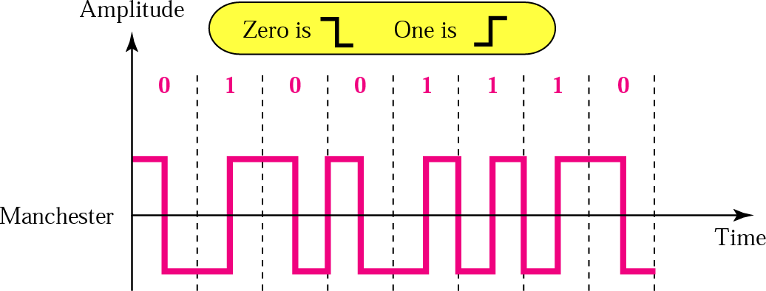



Manchester Encoding
In Manchester encoding, the transition at the middle of the bit is used for both synchronization and bit representation.

Slide 155
Differential Manchester Coding
Code is self-clocking
Transition for every bit in the middle of the bit cell
Transition at the beginning of the bit cell if the next bit is " 0 "
NO Transition at the beginning of the bit cell if the next bit is " 1 "
Used in Token Ring or IEEE 802.5-compliant LANs.

Slide 156
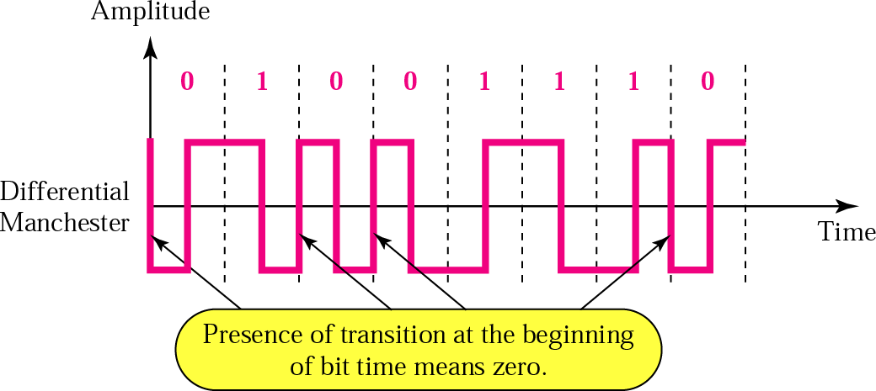





Differential Manchester encoding
In differential Manchester encoding, the transition at the middle of the bit is used only for synchronization.
The bit representation is defined by the inversion or noninversion at the beginning of the bit.

Slide 157
Outline
Introduction of LAN; MAN;WAN; PAN, Ad-hoc Network
Topologies
Network Architectures OSI Model
TCP/IP Model
Design issues for Layers
Transmission Mediums Network Devices
Manchester and Differential Manchester Encodings;
IEEE802.11: Frequency Hopping (FHSS) and Direct Sequence (DSSS)

Slide 158
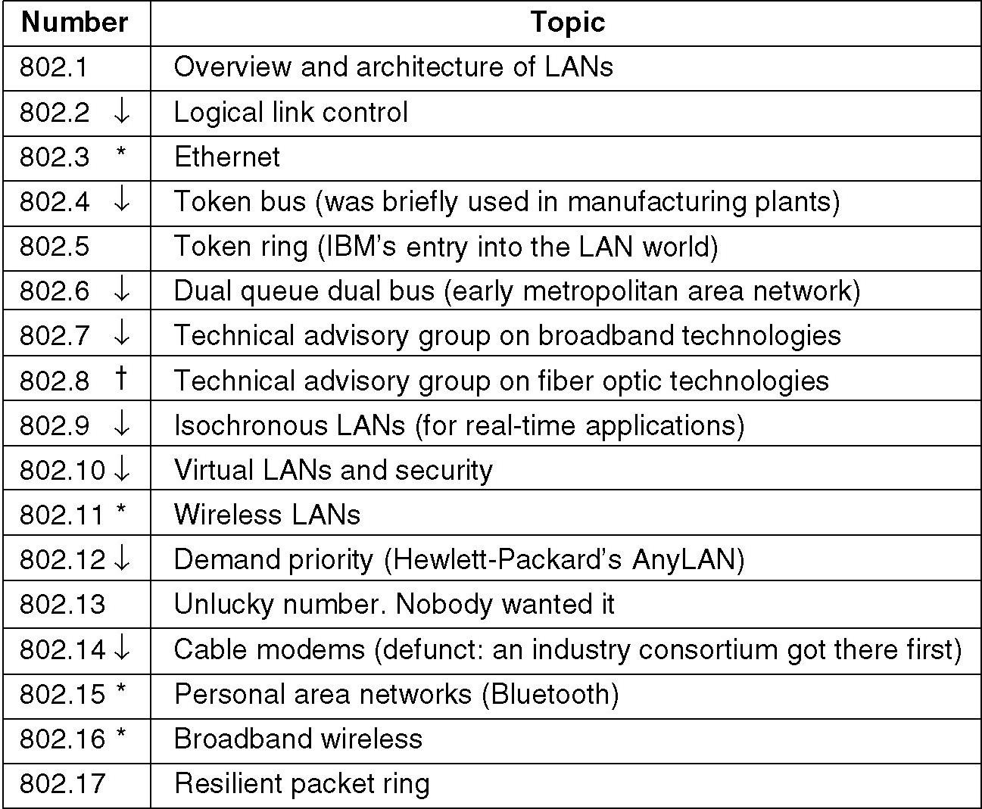
IEEE 802 Standards
The important ones are marked with *. The ones marked with ↓ are hibernating. The
one marked with † gave up.
158

Slide 159





IEEE developed the first internationally recognized wireless LAN standard – IEEE 802.11 in 1997
IEEE 802.11 Wireless LAN Standard
Scope of IEEE 802.11 is limited to
Physical and Data Link Layers.

Slide 160
IEEE 802.11 Standards
802.11a (OFDM Waveform)
802.11b
802.11g
802.11n
802.11ac
802.11ad
802.11af
802.11ah
802.11ai
802.11aj
802.11aq
802.11ax

Slide 161






Physical Media of 802.11 Standard
Frequency- hopping spread spectrum
Direct-sequence spread spectrum
Operating in 2.4 GHz ISM band
Lower cost, power consumption
Most tolerant to signal interference
Operating in 2.4 GHz ISM band
Supports higher data rates
More range than FH or IR physical layers
Lowest cost
Lowest range compared to spread spectrum
Doesn’t penetrate walls, so no eavesdropping
Infrared

Slide 162






What is meant by Spread Spectrum
Spread spectrum is a form of wireless communications in which the frequency of the transmitted signal is varied.This results in a much greater bandwidth than the signal (Bss >> B)
This technique decreases the potential interference to other receivers while achieving privacy.
Two types of Spread Spectrum- FHSS and DSSS

Slide 163


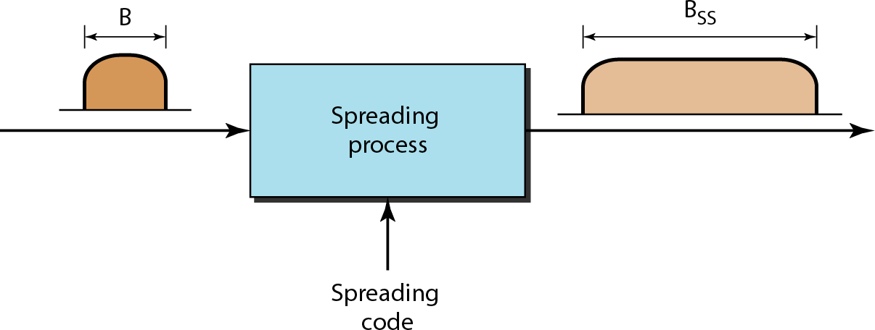
Spread spectrum

Slide 164



Frequency Hopping Spread Spectrum (FHSS)
Signal is broadcast over seemingly random series of radio frequencies
Signal hops from frequency to frequency at fixed intervals
Receiver, hopping between frequencies in synchronization with transmitter, picks up message
Advantages
Efficient utilization of available bandwidth Eavesdropper hear only unintelligible blips
Attempts to jam signal on one frequency succeed only at knocking out a few bits

Slide 165



Frequency hopping spread spectrum (FHSS)

Slide 166



Frequency hopping spread spectrum (FHSS)

Slide 167


FHSS cycles

Slide 168

Bandwidth sharing difference between FDM and FHSS

Slide 169


Direct Sequence Spread Spectrum (DSSS)
Each bit in original signal is represented by multiple bits in the transmitted signal
Spreading code spreads signal across a wider frequency band
DSSS is the only physical layer specified for the 802.11b specification
802.11a and 802.11b differ in use of chipping method 802.11a uses 11-bit barker chip
802.11b uses 8-bit complimentary code keying (CCK) algorithm

Slide 170


Direct Sequence Spread Spectrum (DSSS)

Slide 171



DSSS example

Slide 172
FHSS Vs DSSS
FH systems use a radio carrier that “hops” from frequency to frequency in a pattern known to both transmitter and receiver
Easy to implement
Resistance to noise
Limited throughput (2-3 Mbps @ 2.4 GHz)
DS systems use a carrier that remains fixed to a specific frequency band.The data signal is spread onto a much larger range of frequencies (at a much lower power level) using a specific encoding scheme.
Much higher throughput than FH (11 Mbps)
Better range
Less resistant to noise (made up for by redundancy – it transmits at least 10 fully redundant copies of the original signal at the same time)

Slide 173
Outline
Introduction of LAN; MAN;WAN; PAN, Ad-hoc Network
Topologies
Network Architectures OSI Model
TCP/IP Model
Design issues for Layers
Transmission Mediums Network Devices
Manchester and Differential Manchester Encodings;
IEEE802.11: Frequency Hopping (FHSS) and Direct Sequence (DSSS)

Slide 174
References
Websites:
http://www.studytonight.com/computer-networks/
https://cs.fit.edu/~pkc/classes/dc/slides/ch3.ppt
https://www.techopedia.com/2/29090/networks/lanwanman-an-overview-of-network-types
https://www.slideshare.net/ENGMSHARI/adhoc-networks
http://www.businessdictionary.com/definition/distributed-network-architecture-DNA.html
https://en.wikipedia.org/wiki/Optical_fiber_cable
https://en.wikipedia.org/wiki/Radio_spectrum
https://www.slideshare.net/rupinderj/networking-devices-12807479
https://en.wikipedia.org/wiki/Wireless_access_point
https://www.slideshare.net/LukaXavi/data-encoding
Text Books:
Andrew S.Tenenbaum, “Computer Networks”,5th Edition, PHI, ISBN 81-203-2175-8.
Fourauzan B., "Data Communications and Networking", 5th Edition,Tata McGraw- Hill, Publications, 2006

